Slide 1

Sampling Your Way to Accurate Estimates

Slide 2

Aim of Study
The aim of this study is to estimate population parameters (mean, proportion, and total) related to the Adult dataset using four different sampling strategies: Simple Random Sampling (SRS), Simple Random Sampling With Replacement (SRS WR), Stratified Sampling, and Cluster Sampling.
We want to determine which method provides the most reliable estimates.

Slide 3

Data and Variables of Interest
The Adult Data set consists of 14 variables, including numerical variables such as age, education-num, capital-gain, and hours-per-week. For this study, we will focus on the following variables:
~ Age (numerical)
~ Education-num (numerical)
~ Predicted income category (>50K or <=50K) (categorical)
These represent categorical, continuous, and aggregate measures, respectively, aligning with the three parameters we are required to estimate:
~ Proportion: the proportion of individuals earning more than 50K (categorical).
~ Mean: the average hours worked per week (continuous).
~ Total: the total estimated capital gain across the population (aggregate)

Slide 4
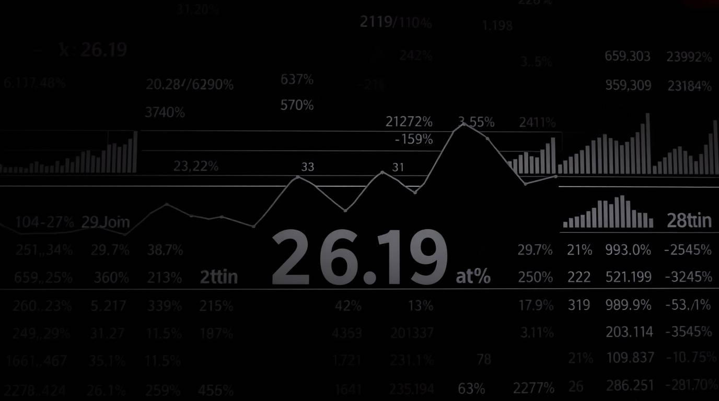
Sampling Types
1. Simple Random Sampling (SRS)
Description: Each individual in the dataset has an equal chance of selection.
SAS code example: proc surveyselect data=adult method=srs sampsize=500 seed=202503 out=sample_srs; run;
2. Simple Random Sampling With Replacement (SRS WR)
Description: Sampling is done with replacement, meaning the same individual can be selected more than once.
SAS code example: proc surveyselect data=adult method=urs sampsize=500 seed=202503 out=sample_srswr; run;
3. Stratified Sampling
Description: The population is divided into strata (e.g., by sex), and samples are drawn proportionally from each stratum.
SAS code example: proc surveyselect data=adult method=srs sampsize=500 seed=202503 out=sample_strata; strata sex; run;
4. Cluster Sampling
Description: The dataset is divided into clusters (e.g., by native-country), and a subset of clusters is randomly chosen, then all individuals in selected clusters are sampled.
SAS code example: proc surveyselect data=adult method=srs sampsize=5 seed=202503 out=sample_cluster; cluster native_country; run;

Slide 5

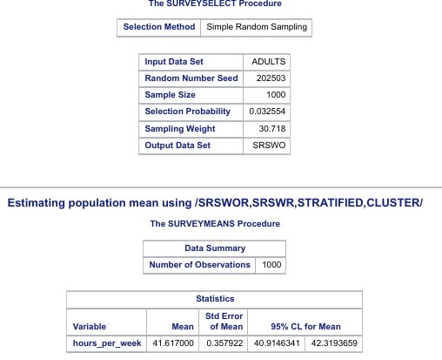
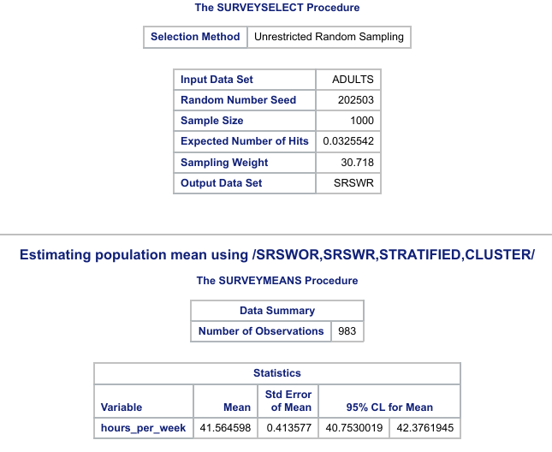
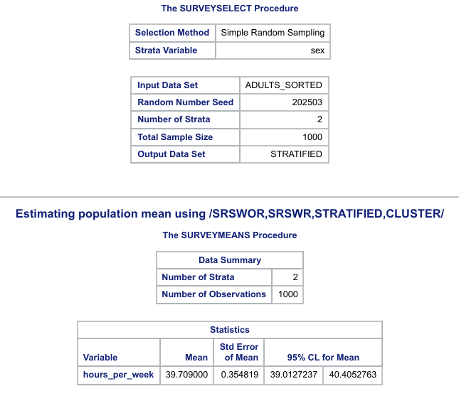
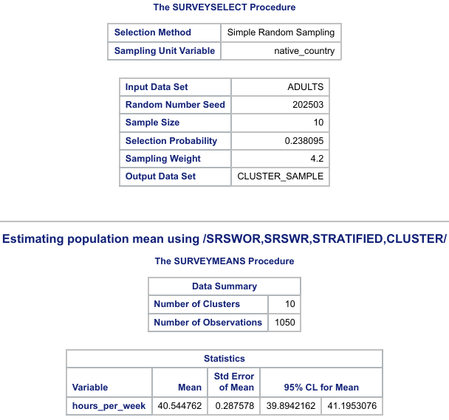
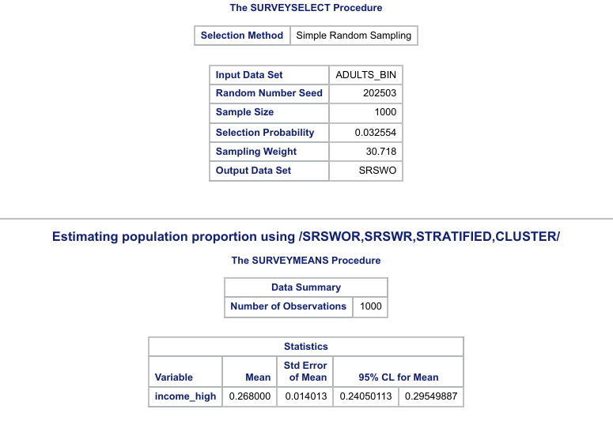
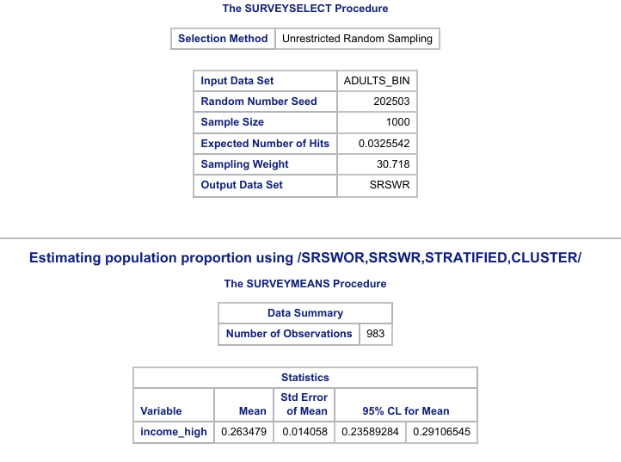
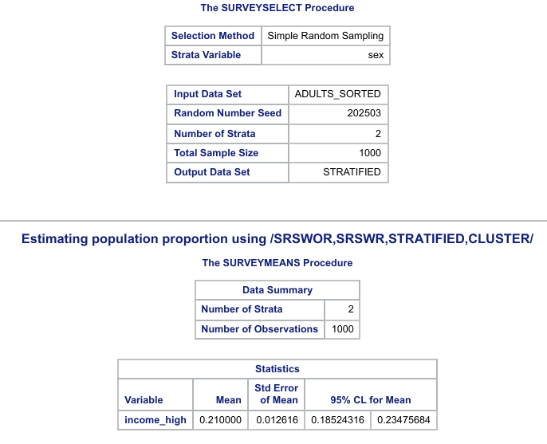
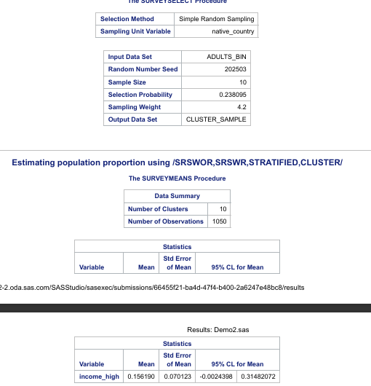
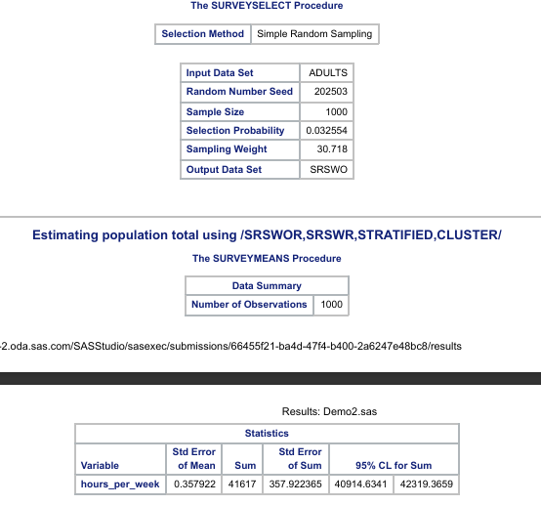
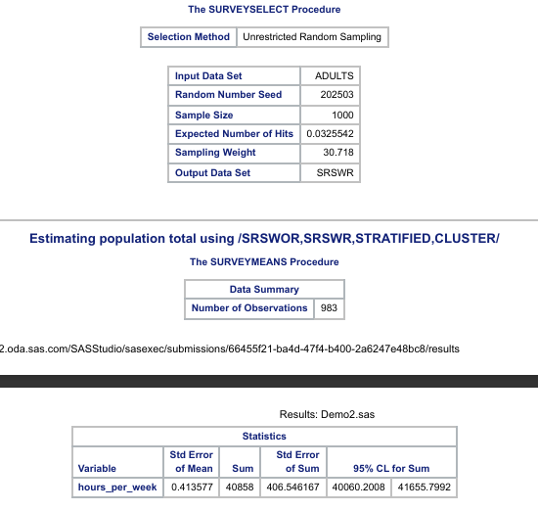
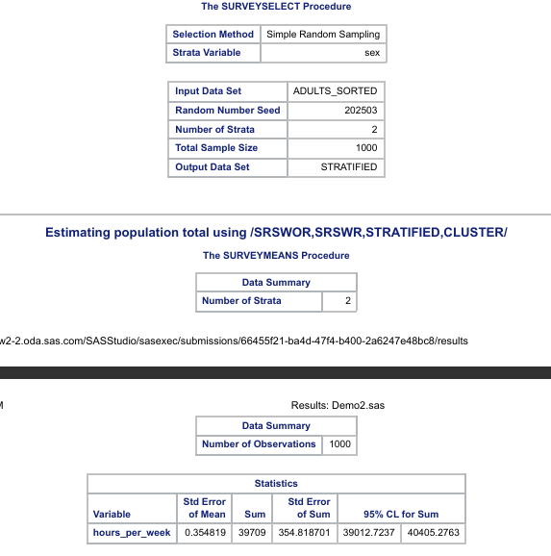
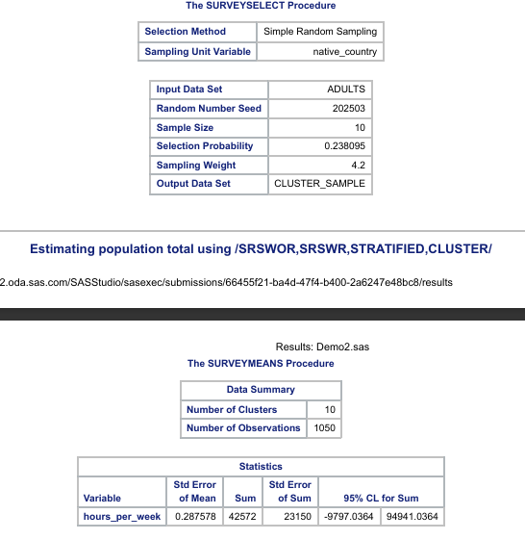
Results

Slide 6

Conclusion
Across all sampling strategies, the estimates are broadly similar, but the precision (narrower confidence intervals) varies:
Stratified sampling produced the most stable and precise estimates, as dividing by sex reduced variability.
SRS gave reasonable results but slightly wider confidence intervals.
SRS WR added more variability since replacement can over-represent some units.
Cluster sampling was the least precise because income and hours can vary widely across clusters (countries).
Final finding: Stratified sampling gave the most reliable estimates in this study, showing the value of accounting for known population structure (here, sex) when sampling.

